Slide 1
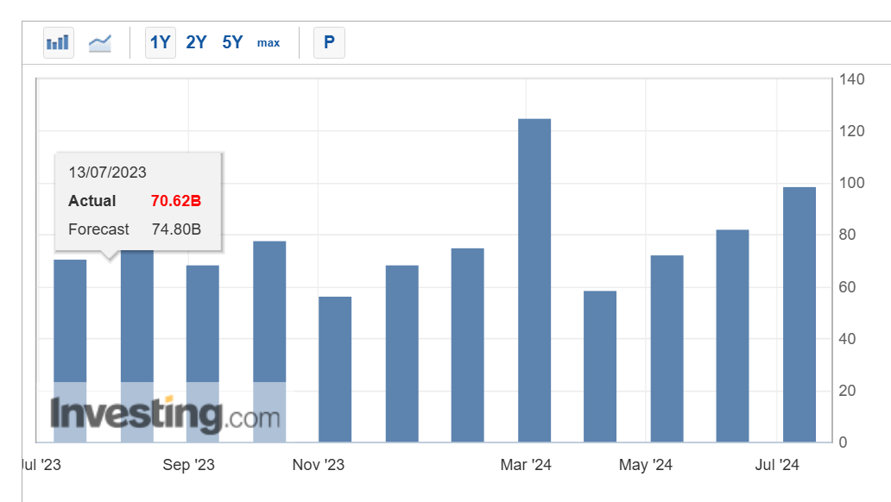
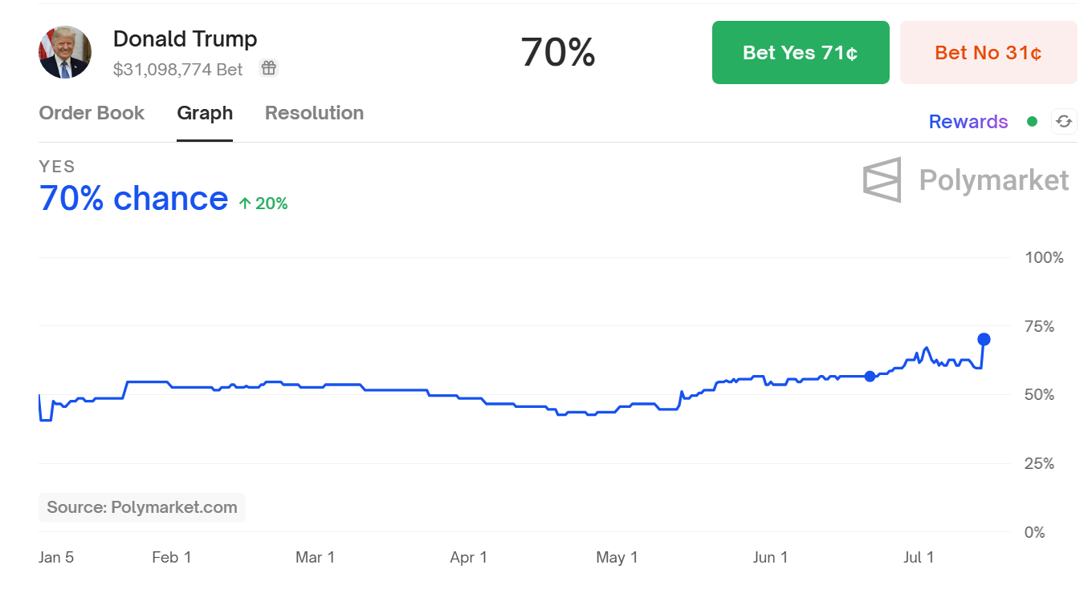
Rolldown Trade Optimization
Trade Idea – USDCNH Implied Yields
Thesis 1: Weaker CNH due to sluggish economic outlook
External: Lower Demand and Geopolitical Risks
China trade account beats expectation but also showed worsened imports (actual -2.3% vs. consensus +2.5%), i.e., lower demand.
BIS annual report underscored the rising volume and dropping export prices of labor-intensive sectors.
US election to be detrimental to Chinese economy outlook regardless of result; depreciation policy might be adopted.
China Trade Balance
Market Expectation of Trump Victory
Yellen: overcapacity
Notes:
Actually we only care market expectation: Biden win rate is decreasing and so market expects China outlook to worsen
Positive correlation of USDCNY fixing and higher probability of Trump victory
Trade account imbalance and BIS report raises tariff by EU (Nov) and US

Slide 2
Rolldown Trade Optimization
Trade Idea – USDCNH Implied Yields
Thesis 1: Weaker CNH due to sluggish economic outlook
Internal: Slower Recovery, Unsurprising Policy Conference
Headline CPI inflation softer than expected (actual 0.2% vs. 0.4% consensus), weaker economy outlook.
PPI deflation persists (June PPI -0.8%, in line with weak-recovery forecast).
The Third Plenum (Jul 15-18) expected to focus on structural reforms instead of short-term easing.
Money Market: Relaxed USDCNY fixing
Thesis 2: Market overpricing Fed September rate cut; First cut in December
Federal Reserves avoids to enter a new rate cycle before the elections
Very limited downside: Market fully pricing in 1 cuts for Sept FOMC meeting. Juicy upside-to-downside ratio on Fed rates.
(Rate cut probi charts)

Slide 3
Appendix: Implied Yield and Depreciation
Correlation
Inflation Expectation:
Higher imports price expected, higher yield demanded for inflationary compensation.
Political Risk Premium:
Foreign investment outflow due to geopolitical risks recently, higher risk premium required for CNH.
PBoC Intervention:
Sell-off plans announced in June; to borrow “hundreds of billions of yuan” and sell in markets as PBoC expects higher yield.
Economic Risk Premium:
Low consumption but overcapacity, lower birth rates and economic tariffs; real estates crisis raised risk aversion level in market, higher risk premium required.

Slide 4
Appendix: Event List For 6M
Correlation
Inflation Expectation:
Higher imports price expected, higher yield demanded for inflationary compensation.
Political Risk Premium:
Foreign investment outflow due to geopolitical risks recently, higher risk premium required for CNH.
PBoC Intervention:
Sell-off plans announced in June; to borrow “hundreds of billions of yuan” and sell in markets as PBoC expects higher yield.
Economic Risk Premium:
Low consumption but overcapacity, lower birth rates and economic tariffs; real estates crisis raised risk aversion level in market, higher risk premium required.

